Slide 1

Weeks 7 and 8 Cloud Enabling Technologies
Cloud Computing
Dr. Rafiullah Khan
ICS/IT
https://rafiyz.github.io/courses/CloudComp/cloud.htm

Slide 2
Cloud Enabling Technology
Modern-day clouds are underpinned by a set of primary technology components that collectively enable key features and characteristics associated with contemporary cloud computing.
Broadband Networks and Internet Architecture
Data Center Technology
Virtualization Technology
Web Technology
Multitenant Technology
Service Oriented Architecture
Utility Computing and others

Slide 3
Overview of Data Center Technology
A data center is a specialized IT infrastructure that houses centralized IT resources, such as servers, databases, and software systems.
Key Components:
Hardware: Standardized commodity servers with high computing power and storage capacity.
Storage Systems: Disk arrays (RAID), storage virtualization, and technologies like DAS, SAN, and NAS.
Networking: High-capacity network hardware, LAN/SAN fabrics, NAS gateways, and content-aware routing.

Slide 4
Key Technologies in Data Centers
Computing Hardware:
Rack-mounted server arrays for high-density computing.
Multi-core CPU architectures for improved performance.
Storage Technologies:
DAS (Direct-Attached Storage): Storage directly connected to servers.
SAN (Storage Area Network): High-speed network for block-level
storage.
NAS (Network Attached Storage): File-level storage accessible over a network.
Networking Innovations:
LAN/SAN fabrics for scalable and efficient connectivity.
Content-aware routing for optimized data delivery.

Slide 5
Virtualization
In computing, virtualization is a broad term that refers to the abstraction of computer resources.
Virtualization is the process of converting a physical IT resource into a virtual IT resource.
The term virtualization broadly describes the separation of a resource or request for a service from the underlying physical delivery of that service.
Example: With virtual memory, for example, computer software gains
access to more memory than is physically installed, via the background swapping of data to disk storage.
Virtualization techniques can be applied to different IT infrastructure layers
- including networks, storage, server and applications
Server Virtualization: A physical server can be abstracted into a virtual server i.e. Virtual Machine (VM).

Slide 6
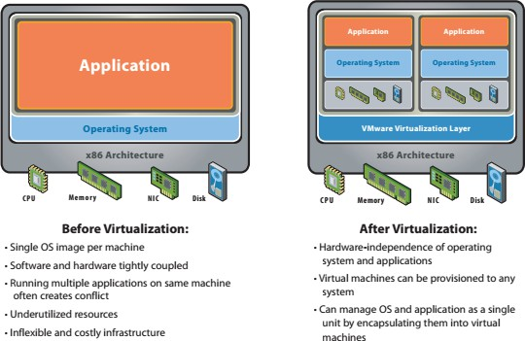
Virtual Infrastructure
This blend of virtualization technologies - or virtual infrastructure - provides a layer of abstraction between computing, storage and networking hardware, and the applications running on it.

Slide 7
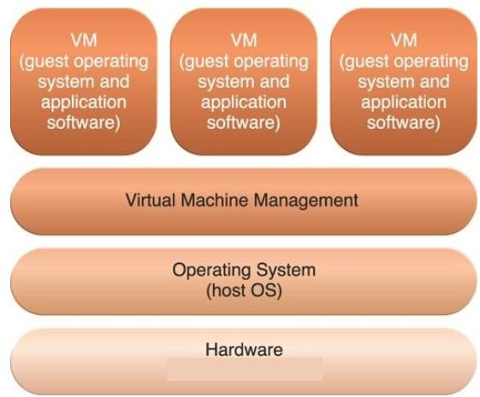
Operating System-Based Virtualization
Operating system virtualization is a technology that allows multiple operating systems to run concurrently on a single physical machine.
Each virtualized OS instance operates as if it were running on its own dedicated hardware, isolated from other virtualized instances and the underlying physical hardware.
Operating system-based virtualization involves installing virtualization software within a pre-existing operating system, known as the host operating system.
Example: A user installs virtualization software into a Windows workstation to generate and operate virtual servers (Vmware, VirtualBox).
Figure illustrate logical layers of operating system-based virtualization, where the VM is installed into a full host operating system to generate virtual machines.

Slide 8
Benefits
Server Consolidation:
Reduce hardware costs by running multiple OS instances on a single physical server.
Improve resource utilization and efficiency.
Isolation:
Enhanced security and stability by isolating applications and environments from each other.
Fault tolerance: Failure of one OS instance does not affect others.
Resource Management:
Dynamic allocation and reallocation of resources such as CPU, memory, and storage among virtualized instances.

Slide 9
Challenges
Performance Overhead:
Full virtualization can introduce overhead due to emulation of hardware.
Security Concerns:
Hypervisor vulnerabilities could potentially expose all virtualized instances to security threats.
Proper security measures and isolation techniques are necessary to mitigate risks.
Licensing:
Licensing considerations for both the virtualization software and the guest OS instances.

Slide 10
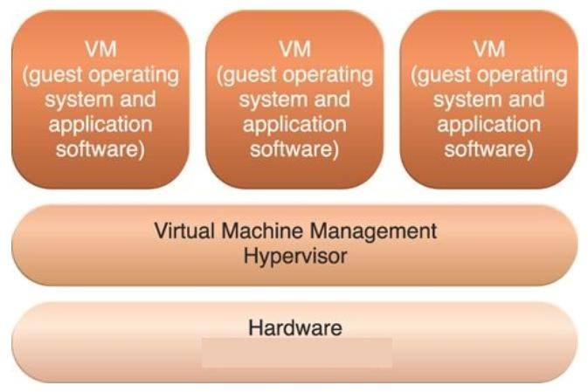
Hardware-Based Virtualization
Hardware-based virtualization involves
installing virtualization software directly on the physical host hardware.
This bypasses the host operating system,
making the interaction between virtual servers and hardware more efficient.
The virtual machine has its own hardware and allows a guest OS to be run in isolation.
Figure illustrates the logical layers of hardware- based virtualization.
Virtualization software in this setup is typically referred to as a hypervisor.

Slide 11
Hypervisor Functionality
A hypervisor acts as a thin layer of software managing hardware functions for virtualization.
It optimizes device drivers and system services for provisioning virtual servers, focusing on performance optimization.
Examples: Xen, KVM (Kernel based Virtual Machine)

Slide 12
Benefits/Challenges
Benefits:
Improved Performance: By bypassing the host operating system, hardware- based virtualization typically offers better performance compared to software-based approaches.
Better Resource Utilization: Virtualization at the hardware level allows for efficient resource allocation and utilization.
Challenges:
compatibility with hardware devices (The virtualization layer communicates directly with host hardware, requiring compatible device drivers and support software)
Host management features may be limited compared to full operating systems.

Slide 13
Application Virtualization
Typically for the purpose allowing application binaries to be portably run on many different computer architectures and operating systems.
http://en.wikipedia.org/wiki/Comparison_of_Application_Virtual_Ma chines
Examples:
.NET CLR
JVM

Slide 14
Some Advantages
Hardware Independence:
Virtual servers can be moved between hosts without hardware-software incompatibility issues.
Easier cloning and manipulation of virtual IT resources compared to physical
hardware.
Server Consolidation:
Multiple virtual servers share one physical server.
Increases hardware utilization, load balancing, and resource optimization.
Supports cloud features like on-demand usage, elasticity, and scalability.
Resource Replication:
Virtual servers are stored as virtual disk images.
Enables easy replication, migration, and backup.
Supports features like rollback (snapshots) and business continuity.

Slide 15



Slide 16

Service
Service Oriented Architecture (SOA)
Service Oriented Computing (SOC)
Reference

Slide 17
Service
Service Oriented Architecture (SOA)
Service Oriented Computing (SOC)
Reference

Slide 18

Programming with
0 and 1
Assembly
Procedural programming language
OOP programming
SOA (Service-oriented architecture)
Service

Slide 19


An entity that provides some capability to its clients by exchanging messages (request - response)
Service
Request
Response

Slide 20

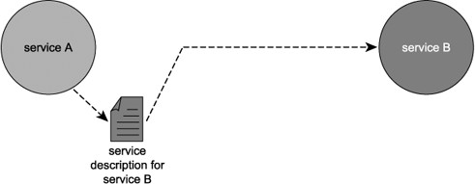
Service Description: a document by which the service provider communicates the specifications for starting the web service to the service requester.
A service description in its most basic format establishes the name of the service and the data expected and returned by the service.
Service

Slide 21
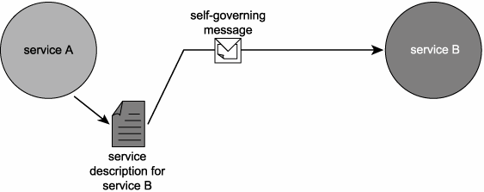
Service

Slide 22

A web service is any piece of software that makes itself available over the internet and uses a standardized XML messaging system. XML is used to encode all communications to a web service. For example, a client invokes a web service by sending an XML message, then waits for a corresponding XML response.
An industry standard
Web Service-related standard
WSDL: describe WS
SOAP message: sent between WS
UDDI (Universal Description, Discovery, and Integration) : register WS
WS-Security: Security for WS
Web Service uses many kind of transport medium: HTTP, SMTP, JMS…
Service

Slide 23




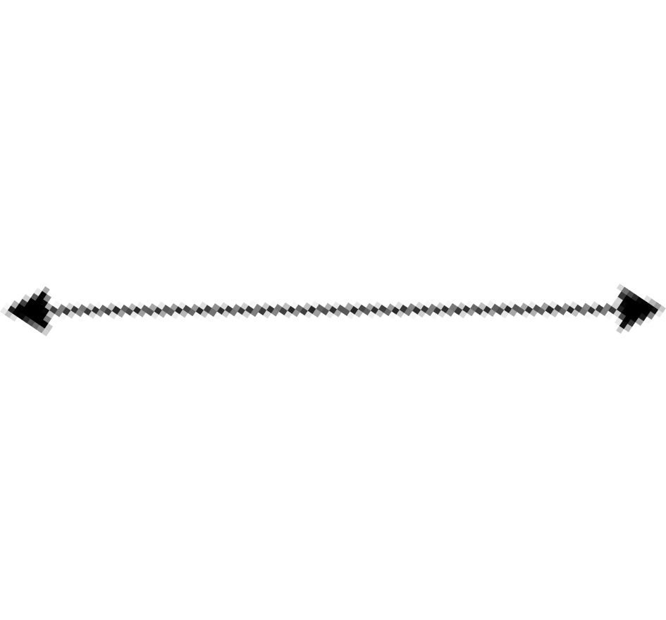
Find
Service Oriented Architecture
Registry
Publish
Bind
Consumer
Provider

Slide 24
Service
Service Oriented Architecture (SOA)
Service Oriented Computing (SOC)
Reference

Slide 25

Service Oriented Architecture
An architectural style of building software applications that promotes loose coupling between components so that you can reuse them and work within a distributed systems architecture
Loose coupling is an approach to interconnecting the
components in a system so that those components, also called elements, depend on each other to the least extent practicable.
This architecture has been wide-accepted
Some SOA product has been built by Oracle (SOA Suite), IBM(Websphere), Microsoft(BizTalk)

Slide 26
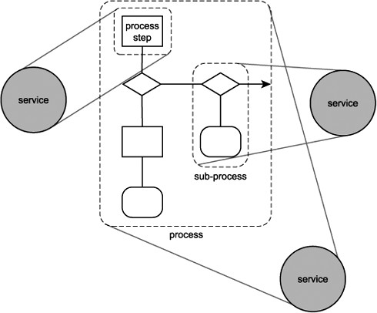
Service

Slide 27

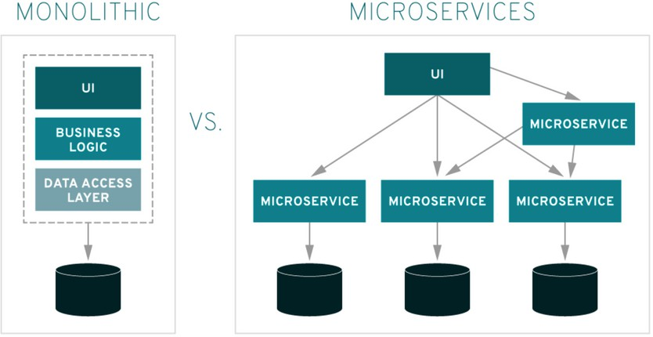

Slide 28
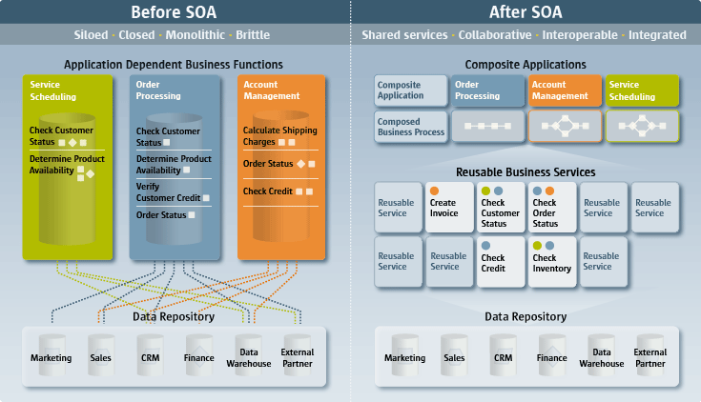
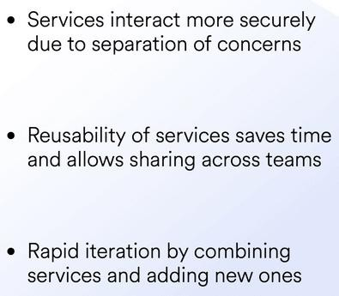

Slide 29

Service Oriented Architecture
Is the core of the SOC platform
Increases quality of service
Greater interoperability
Loosely coupled
Easier to integrate
Increased reuse
Reduce costs

Slide 30
Service
Service Oriented Architecture (SOA)
Service Oriented Computing (SOC)
Reference

Slide 31


SOC is an emerging cross-disciplinary paradigm for distributed computing that is changing the way software applications are designed, architected, delivered and consumed
SOC is a new computing paradigm that utilizes services as the basic constructs to support the development of rapid, low-cost and easy composition of distributed applications even in heterogeneous environments
Service Oriented Computing

Slide 32

The major innovation in SOC is the move from the object oriented paradigm to a service oriented one
Object Oriented:
Object: stateful
Service Oriented:
Service: stateless
Service Oriented Computing

Slide 33
 | Features | Object-oriented computing | Service-oriented computing
 | Methodology | Application development by identifying tightly coupled classes. Application architecture is hierarchical based on the inheritance relationships. | Application development by identifying loosely coupled services and composing them into executable applications.
 | Level of abstraction and cooperation | Application development is often delegated to a single team responsible for the entire life cycle of the application. Developers must have knowledge of application domain and programming. | Development is delegated to three independent parties: application builder, service provider, and service broker. Application builders need to understand application logic and may not know how individual services are implemented. Service providers can program but do not have to understand the applications that use their services.
 | Code sharing and reuse | Code reuse through inheritance of class members and through library functions. Library functions have to be imported at compilation time and are platform dependent. | Code reuse at the service level. Services have standard interfaces and are published on Internet repository. They are platform-independent and can be searched and remotely accessed. Service brokerage enables systematic sharing of services.
 | Dynamic binding and recomposition | Associating a name to a method at runtime. The method must have been linked to the executable code before the application is deployed. | Binding a service request to a service at runtime. The services can be discovered after the application has been deployed. This feature allows an application to be recomposed at runtime.
 | System maintenance | Users need to upgrade their software regularly. The application has to be stopped to perform the upgrading. | The service code resides on service providers' computers. Services can be updated without users' involvement.
Service Oriented Computing

Slide 34

All major computer corporations, including BEA, IBM, Microsoft, Oracle, HP, SAP, Intel, Cisco, Juniper, SAP, and Sun Microsystems, have moved towards the SOC paradigm
SOC is being adopted by major computer uses, including banks (Web banking services), retailers (Web shopping services), airlines (Web booking services)…
Service Oriented Computing

Slide 35

Service Oriented Architecture
Service Orientation
Service Oriented Solution Logic
Services
Service Compositions
Service Inventory

Slide 36



Services can be composed of other services
Services can be composed by using other services in a business logic
SOC Elements

Slide 37



A service inventory is an independently standardized and governed collection of complementary services within a boundary that represents an enterprise or a meaningful segment of an enterprise
SOC Elements

Slide 38
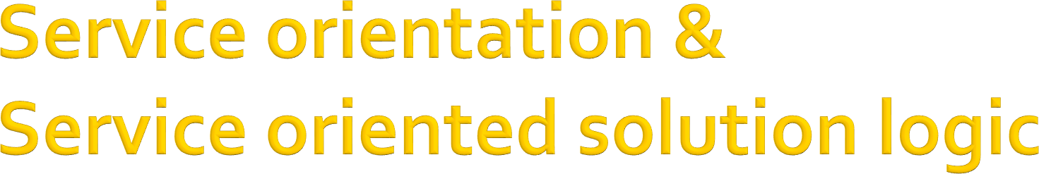
Service orientation:
Is a design paradigm comprised of a specific set of design principles
Specifies the creation of automation logic in the form of services
Service oriented solution logic:
The application of these design principles to the design of solution logic results in service oriented solution logic
SOC Elements

Slide 39

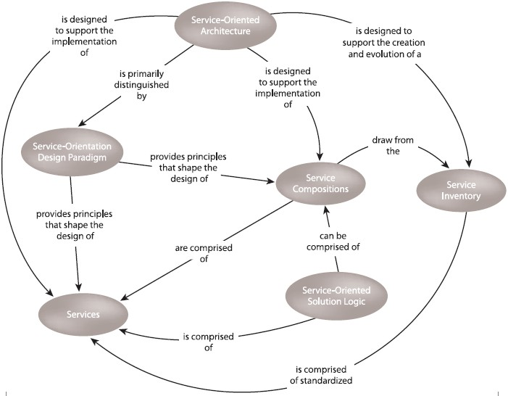
Service Oriented Computing

Slide 40
Service-oriented solution logic is implemented as services and service compositions
designed in accordance with service-orientation design principles.
A service composition is comprised of services that have been assembled to provide the functionality required to automate a specific business task or process.
Because service-orientation technology shapes many services as agnostic enterprise resources, one service may be invoked by multiple consumer programs, each of which can involve that same service in a different service composition.
A collection of standardized services can form the basis of a service inventory that can be independently administered within its own physical deployment environment.
Multiple business processes can be automated by the creation of service compositions
that draw from a pool of existing agnostic services that reside within a service inventory.
Service-oriented architecture is a form of technology architecture optimized in support of services, service compositions, and service inventories.

Slide 41

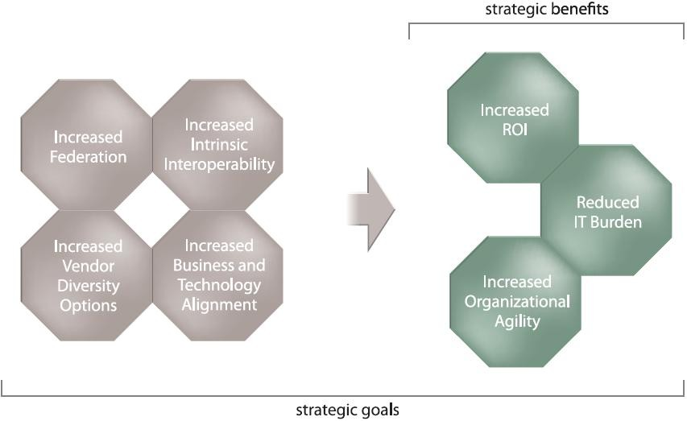
Service Oriented Computing

Slide 42
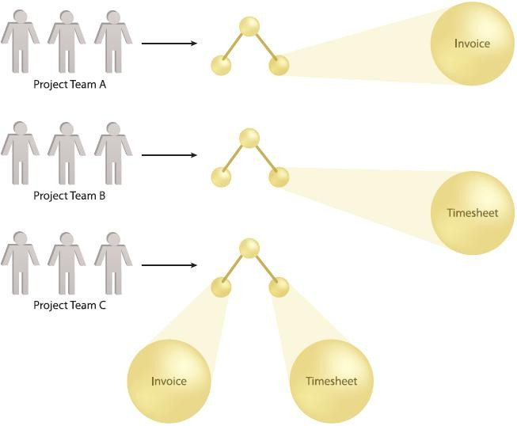

Goals & benefits

Slide 43
The more interoperable software programs are, the easier it is for them to exchange information
Integration can be seen as a process that enables interoperability
Goals & benefits

Slide 44
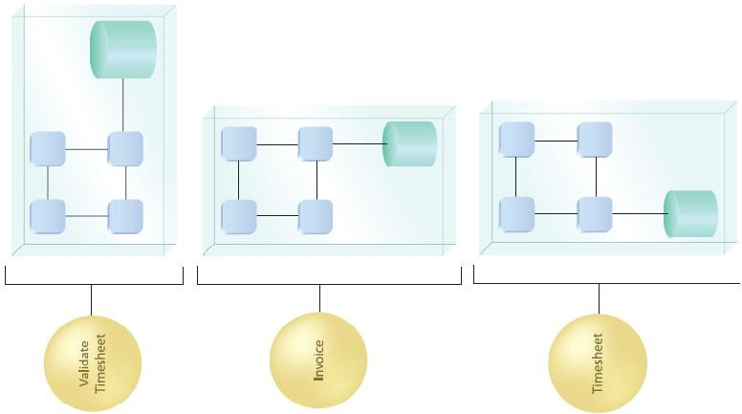
Goals & benefits

Slide 45
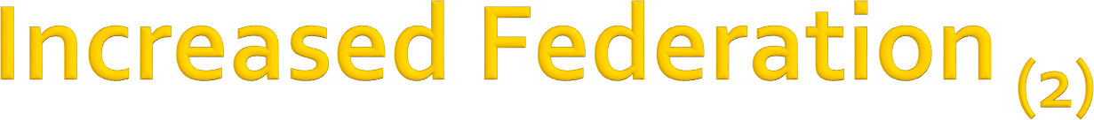
A federated IT environment is one where resources and applications are united while maintaining their individual autonomy and self-governance
SOA aims to increase a federated perspective of an enterprise to whatever extent it is applied
Goals & benefits

Slide 46

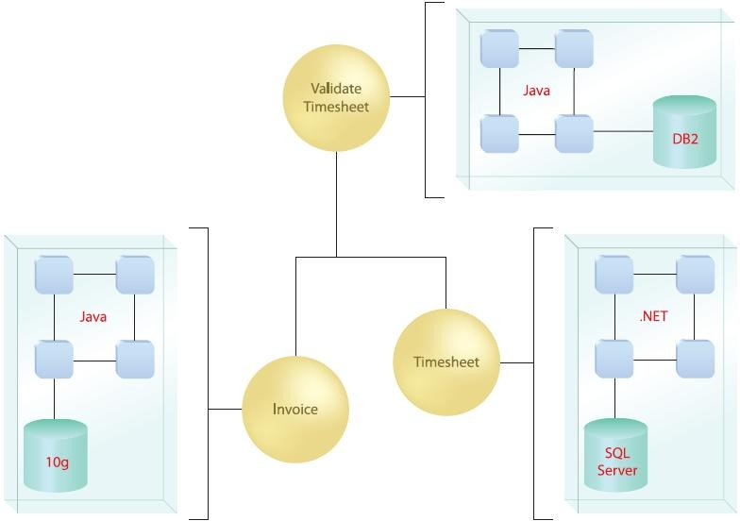
Goals & benefits

Slide 47
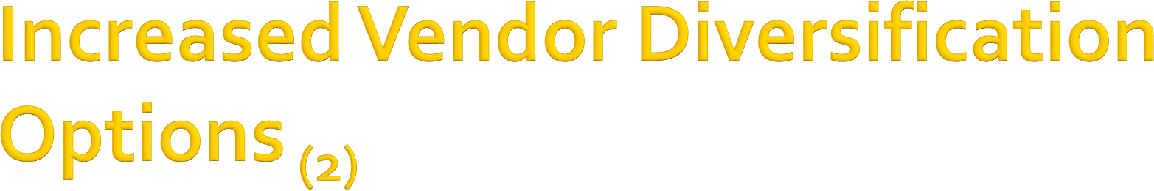
Vendor diversification refers to the ability an organization has to pick and choose “best-of-breed” vendor products and technology innovations and use them together within one enterprise
Vendor diversification is further supported by taking advantage of the standards- based, vendor-neutral Web services framework
Goals & benefits

Slide 48

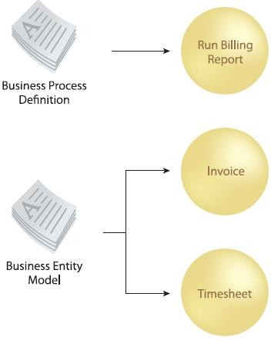
Goals & benefits

Slide 49

Service-oriented computing introduces a design paradigm that promotes abstraction on many levels. One of the most effective means by which functional abstraction is applied is the establishment of service layers that accurately encapsulate and represent business models
Services are designed to be intrinsically interoperable directly facilitates business change
Goals & benefits

Slide 50

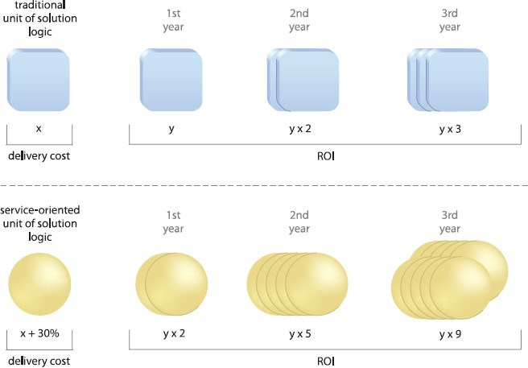
Goals & benefits

Slide 51
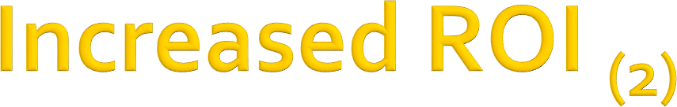
Measuring the return on investment (ROI) of automated solutions is a critical factor in determining just how cost effective a given application or system actually is
Service-oriented computing advocates the creation of agnostic solution logic—logic that is agnostic to any one purpose and therefore useful for multiple purposes
Goals & benefits

Slide 52
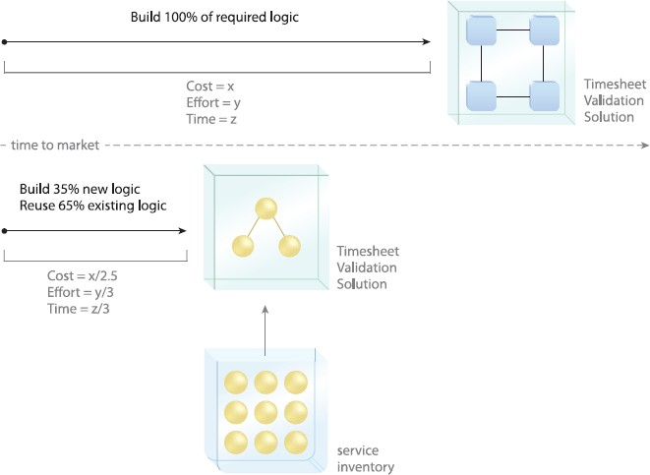
Goals & benefits

Slide 53
Agility, on an organizational level, refers to the efficiency with which an organization can respond to change
Increasing organizational agility is very attractive to corporations, especially those in the private sector
Goals & benefits

Slide 54
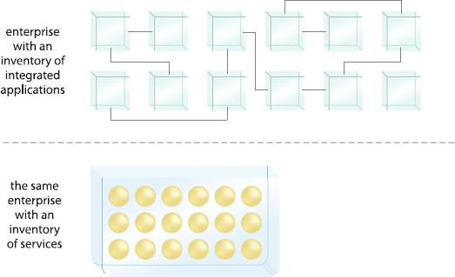
Goals & benefits

Slide 55
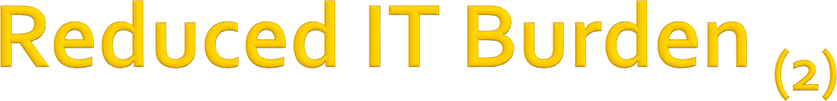
Consistently applying service-orientation results in an IT enterprise with reduced waste and redundancy, reduced size and operational cost and reduced overhead associated with its governance and evolution
An enterprise can benefit an organization through dramatic increases in efficiency and cost-effectiveness
Goals & benefits

Slide 56
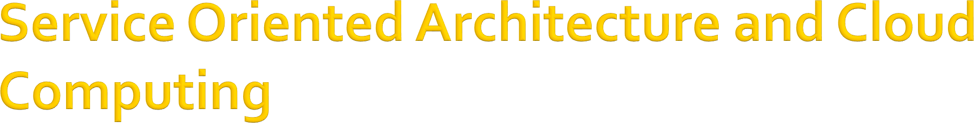
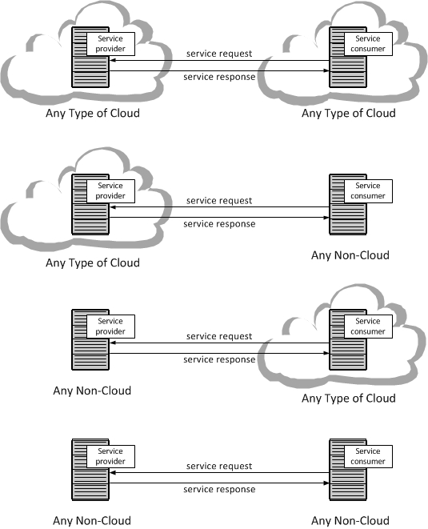
A service provider can be in a Cloud or not in a Cloud and a service-oriented architecture (SAO) can involve any combination of Clouds and Non-Clouds as is illustrated in the figure.

Slide 57

SOA: Principles of Service Design, Thomas Erl, Prentice Hall
Introduction to Service oriented computing,
W.T.Tsai & Yinong Chen
[3] Service oriented computing: Key concepts and principles, Michael N. Huhns & Munindar P.Singh

Slide 58

Clarify the difference between Restful and SOAP Web Services using examples

Slide 59
Thanks for your attention!

